Slide 1


The US Real Estate Market: An Exploratory Data Analysis
Chris Tanner, Noah Eiseman &
Joseph Lomas

Slide 2

Overview
The Zillow’s public data files include datasets on home value, rental prices, sales, and other valuable statistics that can be used to evaluate the U.S. residential home market.
Data is available for all 50 states and close to 1,000 U.S regions.
Datasets used:
Zillow Observed Rent Index
Median Sale Price
Home Value Forecast
Days to Close
Percent of Sales Over List
Main Questions:
Where is it best to rent vs. buy?
Where is it best to be a buyer vs. a seller?

Slide 3
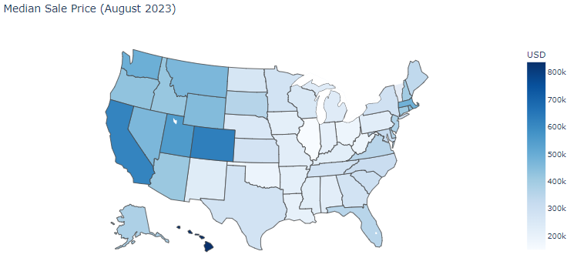
Median sale price varies by region, with the West Coast experiencing higher sale prices than the East Cost
Hawaii, California, and Colorado lead the U.S. in median sale price
Hawaii’s median sale price is more than $100,000 greater than California’s median sale price. The combination of low housing supply and high demand for homes in Hawaii drives the price up.
California and Colorado are highly desirable states for home buyers that are looking for primary residents and vacation homes

Slide 4
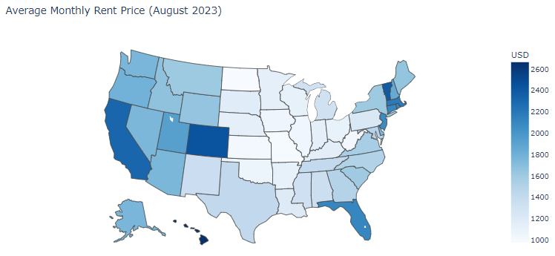
The regional trend somewhat holds up when looking at average monthly rent, with Hawaii, California, and Colorado leading, but East Coast states like Florida and Massachusetts also have high monthly rental rates.
In Massachusetts, Boston is home to leading college institutions and industry leaders like Microsoft, StateStreet, and Amazon that drive rental prices up
In Florida, advantageous tax laws and demand for homes close to the beach translates to higher rental prices
Furthermore, New Jersey’s proximity to New York City drives up rental prices specifically in North Jersey

Slide 5
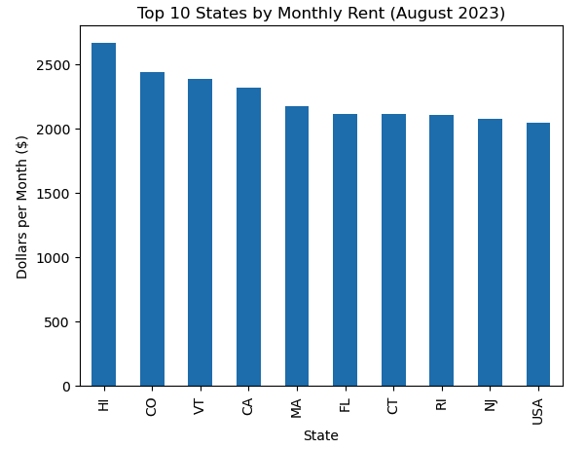
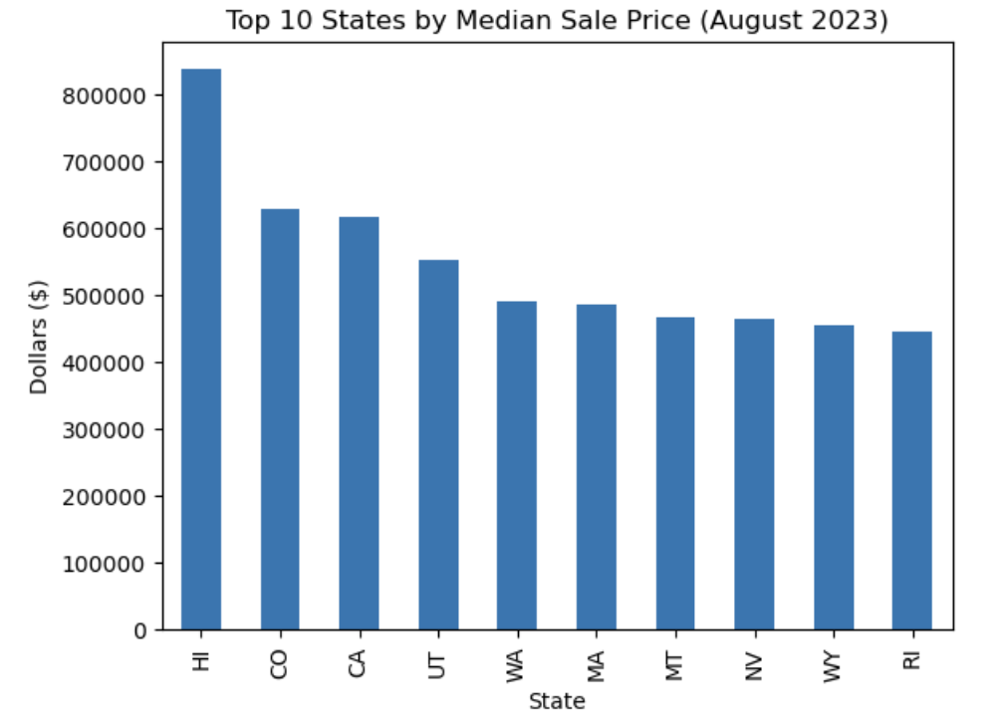
Rent Comparison

Slide 6
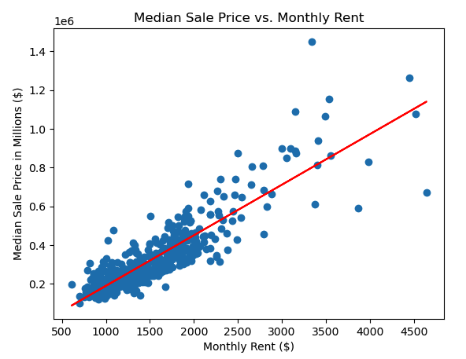
The correlation between the rent price and median sale price is 0.87
The chart to the left shows a scatter plot of median sale price and monthly rent, showing the two variables are highly correlated
As monthly rent increases in a region, so does the median sale price
Where is it better to be a renter? In regions above the red line.
Where is it better to be a homeowner? In regions below the red line.

Slide 7
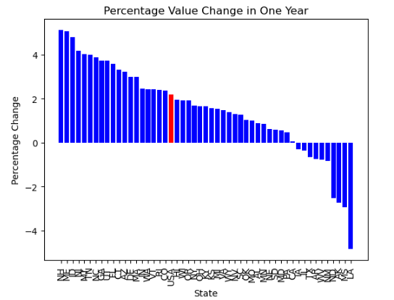
Top 5 Increase
New Hampshire
Maine
Idaho
New Jersey
Montana
Top 5 Decrease
Louisiana
Mississippi
Arkansas
North Dakota
New Mexico

Slide 8
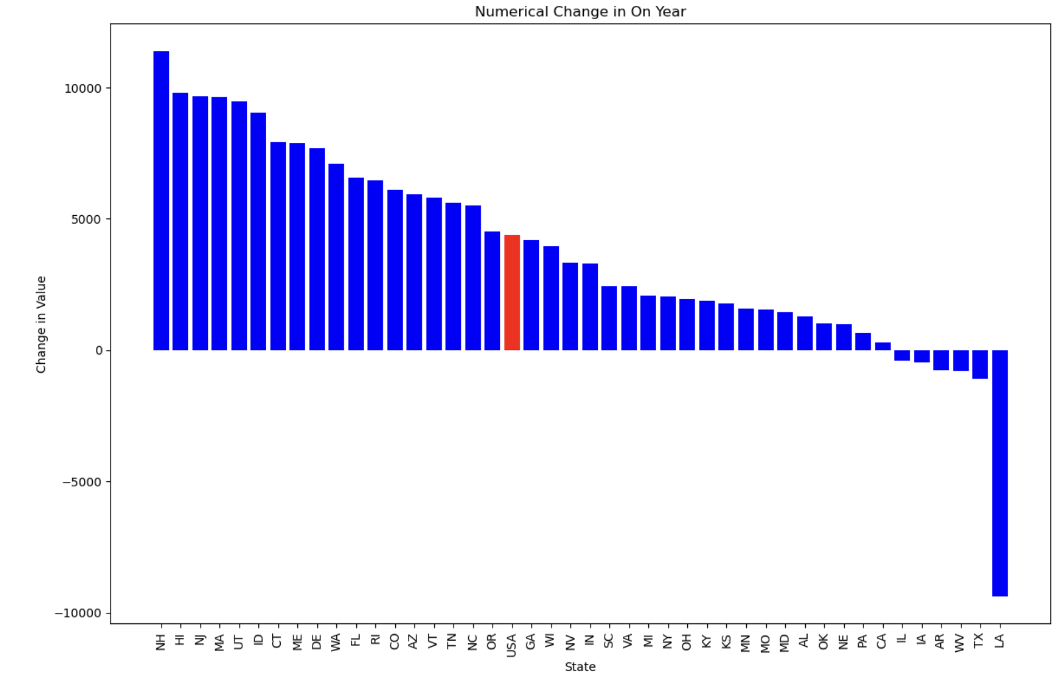
Top 5 Increase
New Hampshire
Hawaii
New Jersey
Massachusetts
Utah
Top 5 Decrease
Louisiana
Texas
West Virginia
Arkansas
Iowa

Slide 9
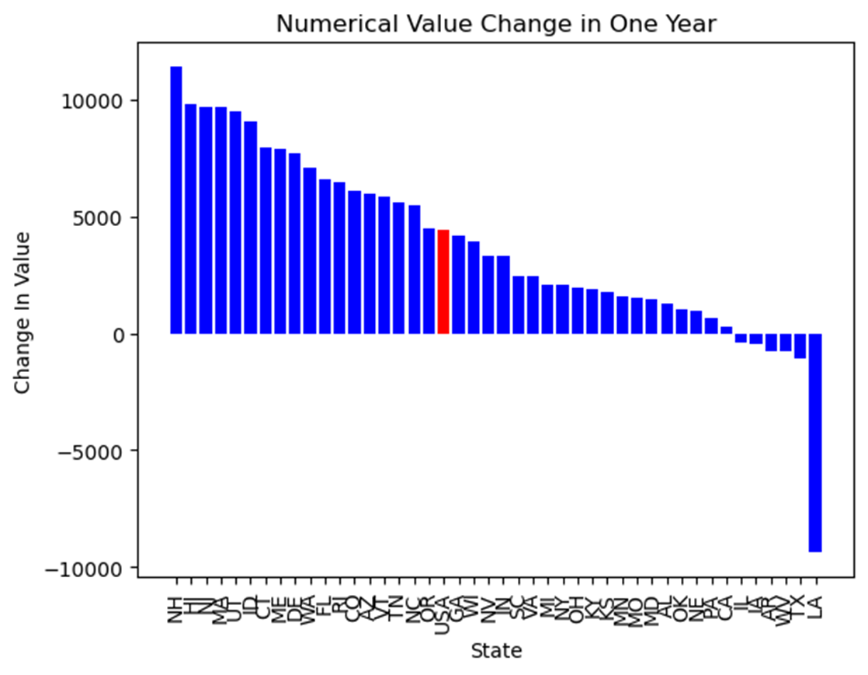
Percent & Value
Percent Top 11
NH 5.12%
ME 5.07%
ID 4.78%
NJ 4.17%
MT 4.04%
TN 3.98%
NC 3.88%
GA 3.73%
UT 3.72%
FL 3.59%
Numeric Top 11
NH $11,396.61
HI $9819.95
NJ $9685.39
MA $9653.55
UT $9482.98
ID $9049.18
CT $7918.54
ME $7878.84
DE $7697.81
WA $7092.61
FL $6582.93

Slide 10
Percent & Value
Percent Bottom 6
LA -4.841%
WV -0.771
AR -0.775%
TX -0.670%
IL -0.361%
IA -0.305%
Numeric Bottom 6
LA -$9367.68
TX -$1091.19
WV -$788.83
AR -$771.66
IA -$476.20
IL -$394.13
No Given Home Value:
MS -2.940%*
AK -2.725%*
ND -2.528%*
NM -0.827%*

Slide 11
Closing Time & Percent of Homes Sold Above Listing
Closing Time
Home Inspection
Appraisal Issues
Ease of Process
Percent Above Listing
Competitiveness of that market

Slide 12
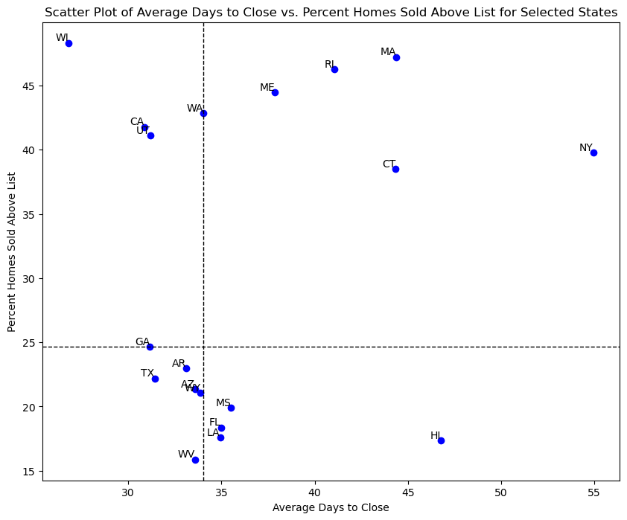
Best for Sellers (Quadrant II)
WI
CA
UT
WA
Best for Buyers Quadrant (III)
TX
GA
AR
AZ
WY
WV

Slide 13
Let’s Answer Our Questions

Slide 14
Where do you want to be a buyer?
New Jersey:
Top 14 Home Value
Top 4 in Numerical & Percentage Home Value Increase
8th Highest Rental
Below Average Home Sold Above Listing

Slide 15
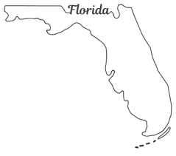
Where do you want to be a buyer?
Florida:
Top 6 in rental pricing
4th Lowest in Percent Sold Above Listing
Top 10 in Percent and Numeric Value Change
Average Closing Time

Slide 16

Where do you want to be a buyer?
Arizona:
7th Lowest Percent Sold Above Listing
12th Highest Percentage Forecast Value Change
14th Highest Numerical Change
Low Closing Time
High Rent

Slide 17

Where do you want to be a seller
Wisconsin:
2nd Highest State in Sold Above Listing
Lowest Average Days to Close
Bottom 10 in Monthly Rent
Above Average Home Value (16th)

Slide 18

Where do you want to be a seller
California:
7th Lowest Numerical Increase
Lowest of All Positive States
Only Top 10 State in Home Value that’s also in Bottom 20% of Percent & Numeric Increase
7th Highest Sold Above Listing
2nd Lowest Average Days to Close

Slide 19
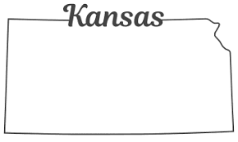
Where do you want to be a seller
Kansas:
3rd Lowest Rent
Top 16 In Percent Sold Above Listing
Bottom Half in Percentage Increase
Bottom 15 in Numerical Increase
Bottom 10 of positive increases

Slide 20
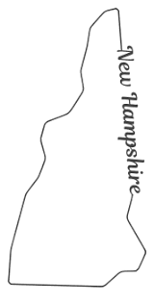
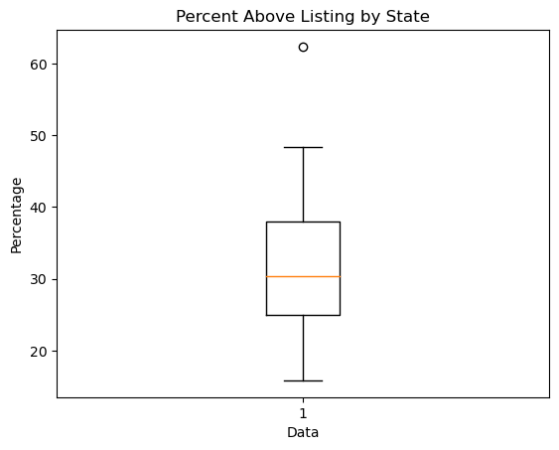
Buyer and Seller? New Hampshire
Seller
1st in Homes Sold Above Listing
Buyer
1st in Numerical Home Value Increase
1st in Percentage Home Value Increase
Top 10 in Rent

Slide 21
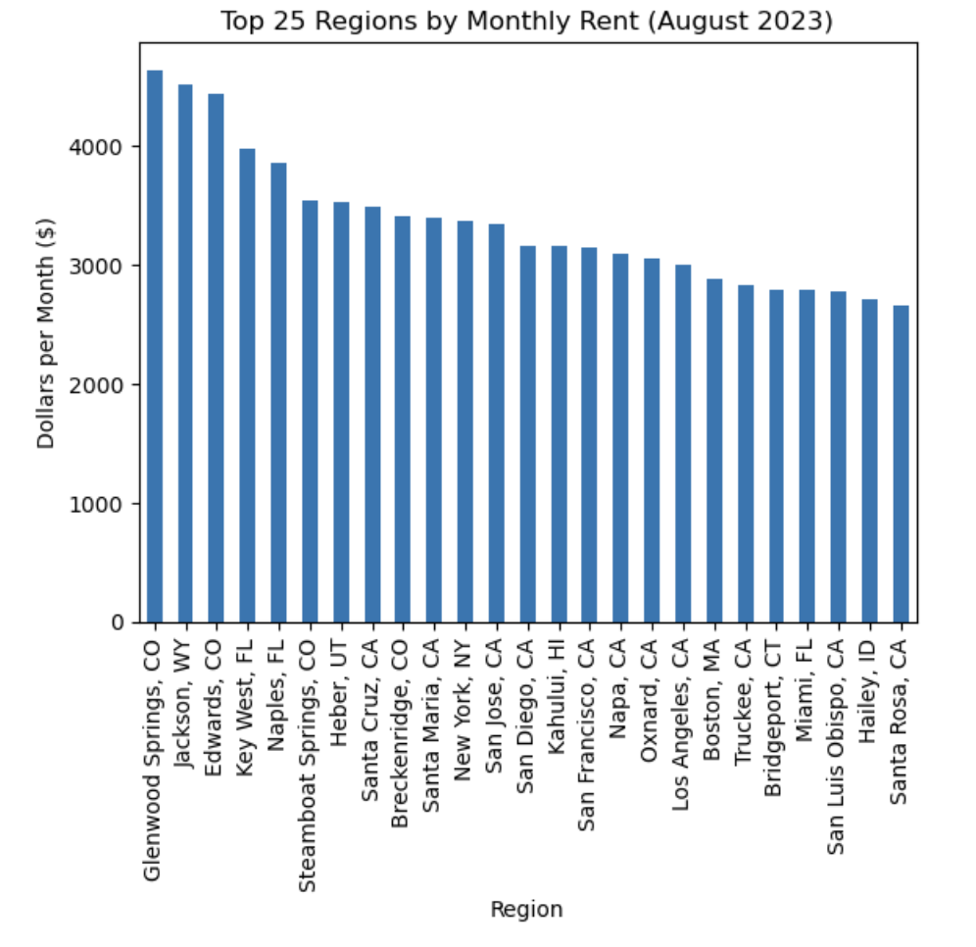
Appendix: Top Monthly Rent

Slide 22
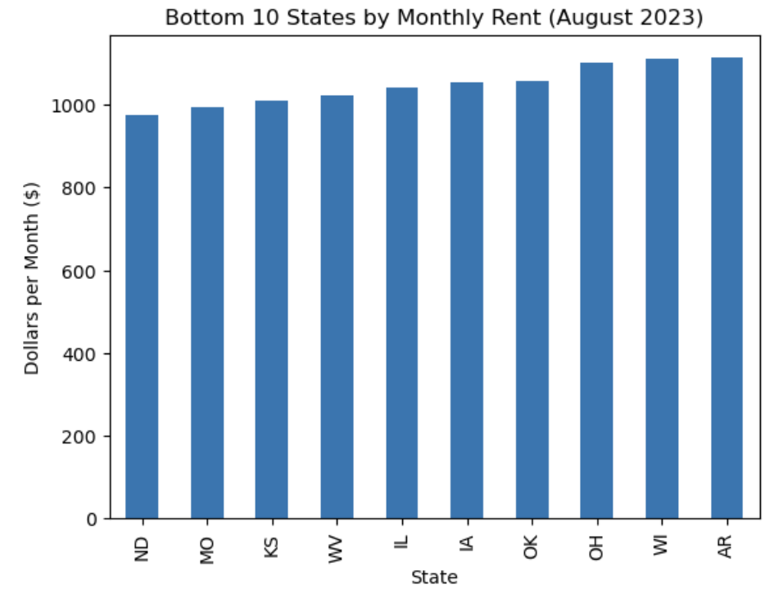
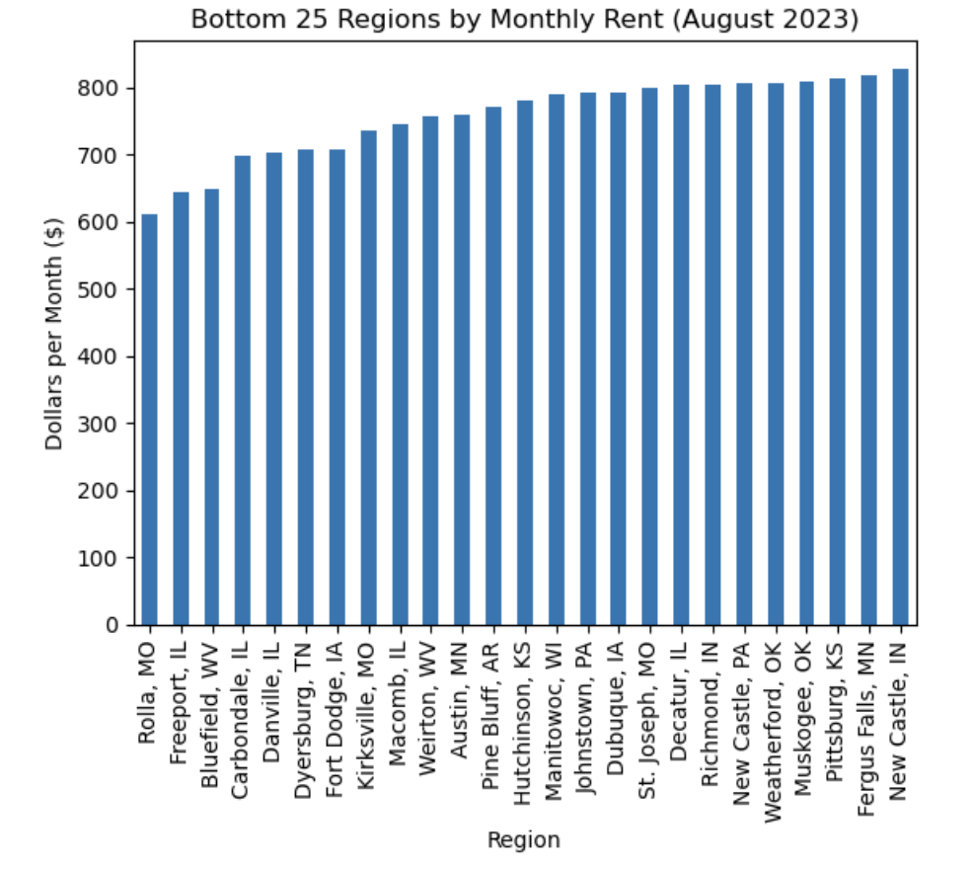
Appendix: Bottom Monthly Rent

Slide 23
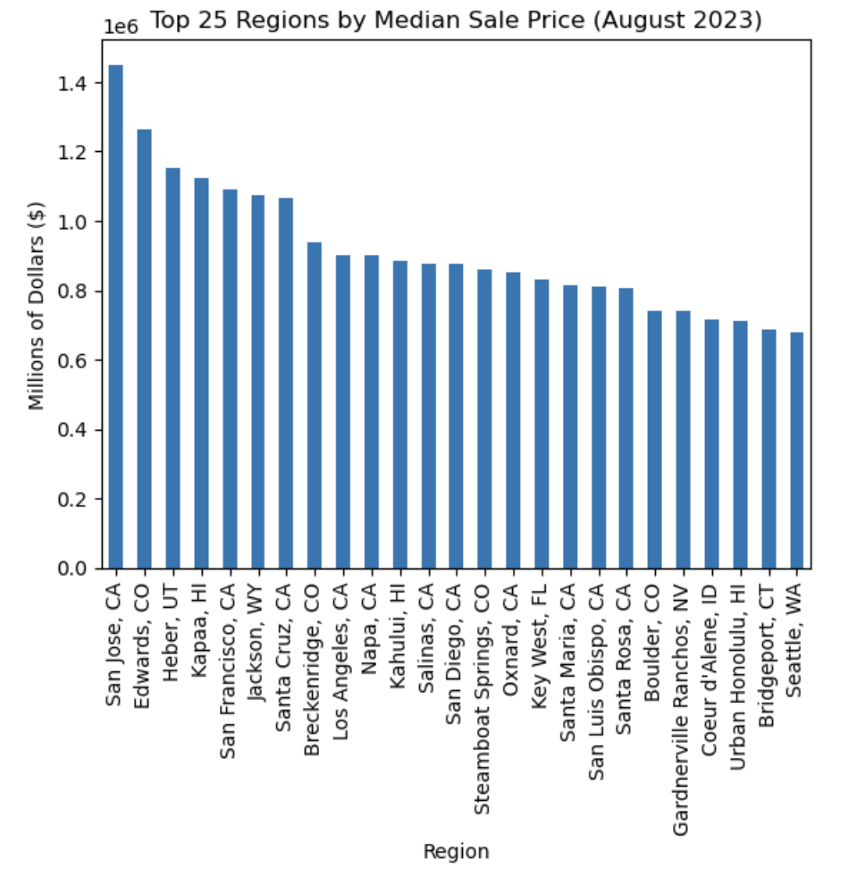
Appendix: Top Median Sale Price

Slide 24
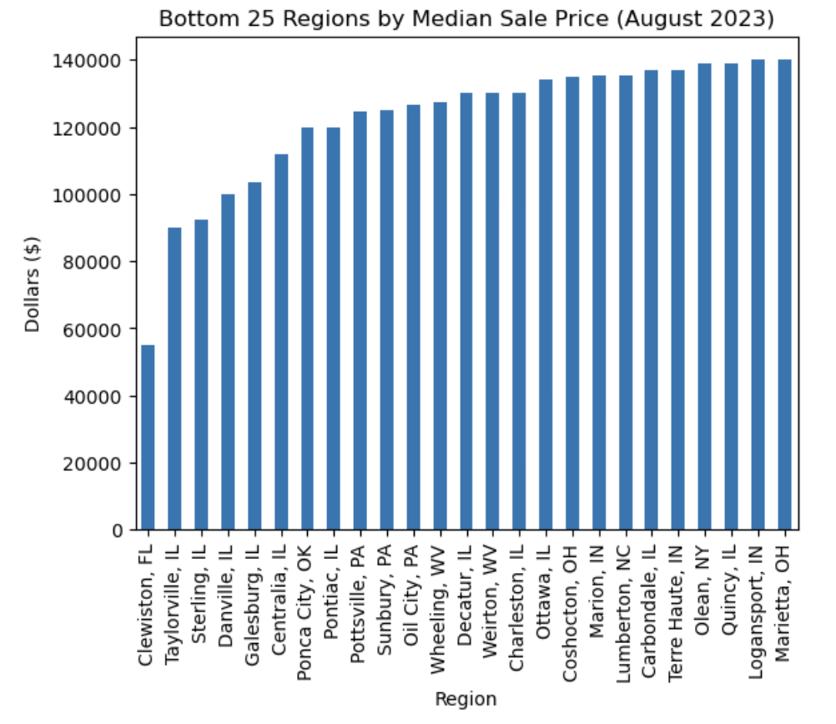
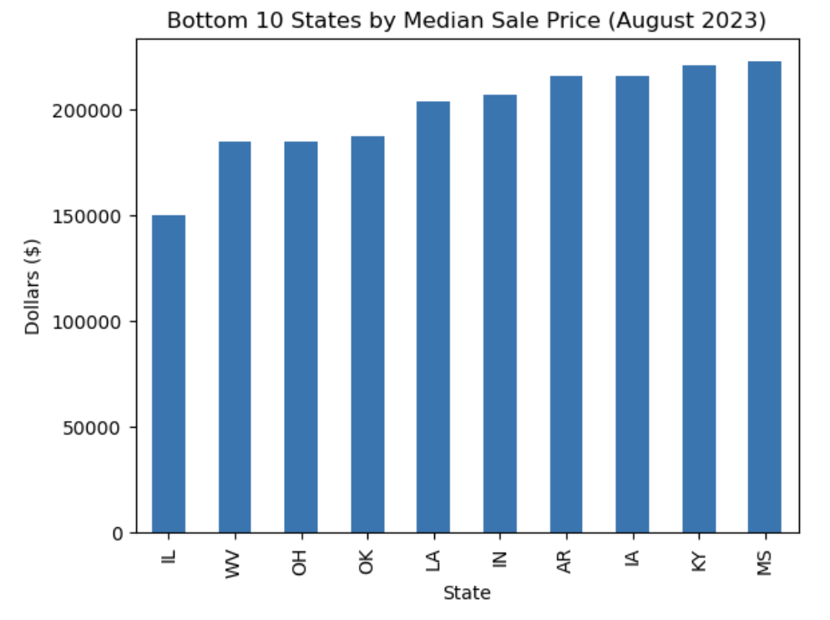
Appendix: Bottom Median Sale Price

